Slide 1
PA Use of Flexibility in Specialty, Role, Employer, and Setting Choice
AAMC Health Workforce Research Conference
May 5, 2017
Tim McCall, PhD
Research Analyst
Najeebe Danielle Melton, MBA
Research Assistant
Noël Smith, MA
Senior Director, PA and Industry Research and Analysis
American Academy of PAs

Slide 2
Background
PAs are trained in a generalist medical model, which allows PAs to change their employer, setting, and specialty to meet the changing health workforce needs.
The purpose of this study is to examine career flexibility among PAs, including changes in specialty, setting, employer, and role.
We hypothesize that PAs who made a career change in 2015 would report higher levels of satisfaction with their career and equal or low levels of life stress compared to those who did not make a change.

Slide 3
Methodology
Data Source
Data year is 2015
2016 AAPA Salary Survey
15,999 total responses
Response rate 16.4%; MOE +/- 0.72%
Respondents were representative of the PA population
Notes:
Data were collected through the 2016 AAPA Salary Survey. With 15,999 responses, the response rate was 16.4%. The demographics of the sample were comparable to those published by the NCCPA (which has data that closely approximates the PA universe), indicating the representativeness of our sample in light of a low response rate . The authors examined characteristics of PAs who experienced career changes in 2015 in the form of specialty, setting, employer, and role changes by employing analysis of variance, descriptive, and column proportion statistics.

Slide 4
Key Finding 1 Overall Changes
5.5% changed their specialty
5.6% changed their setting
5.3% changed their role
11.0% changed their employer

Slide 5
Key Finding 2 Top 5 Reasons PAs Change Their Specialty
5.
4.
3.
2.
1.
Always intended to change specialties after getting a broad knowledge based in primary care (10.7%)
Moving (11.4%)
Better work-life balance (14.3%)
Ready for a change (15.0%)
To work in a higher paying specialty (23.3%)
Notes:
This indicated that PAs did not necessarily intend to change their specialty; rather they sought to change other aspects of their professional career such as hours, location, and compensation.

Slide 6
Key Finding 3 Who Is Making Changes?
PAs Who Changed Anything
- Less experience (9.0 vs.10.6 years)
- Younger (38.6 vs.39.9 years)
- Female (69.6% vs. 65.6% female)
Changed Specialty
- Less experience (7.5 vs.10.5 years)
- Younger (37.1 vs. 39.9 years)
- Female (72.8% vs. 65.9%)
Changed Role
- Less experience (9.0 vs. 10.4 years)
Changed Employer
- Less experience (8.81 vs. 10.5 years)
- Younger (38.5 vs. 39.9 years)
Setting
- Less experience (8.9 vs. 10.4 years)

Slide 7
Key Finding 4 Increased Consultation With Collaborating Physician
Percentage of time spent consulting with a collaborating physician on a weekly basis
18.4% for those who did not change their specialty
22.4% for those who did

Slide 8
Key Finding 5 Dissatisfaction With Employer
Across changes in role, employer, setting, and specialty
MORE PAs who made a change were dissatisfied with their employer
MORE PAs who made a change were unlikely to recommend their employer to others
Among those who changed employers,
FEWER PAs who changed employers were satisfied with their current employer
FEWER PAs who changed employers indicated that they were somewhat likely to recommend their current employer
Notes:
Across changes in role, employer, setting, and specialty
MORE PAs who made a change were dissatisfied with their employer ( 13.9% v 10.3%)
MORE PAs who made a change were unlikely to recommend their employer to others (14.7% v 11.6%)
Among those who changed employers,
FEWER PAs who changed employers were satisfied with their current employer (48.% v 53.1%)
FEWER PAs who changed employers indicated that they were somewhat likely to recommend their current employer (36.3% v 32.6%)

Slide 9
Key Finding 6 Increased Life Stress
Changed Role
Greater overall life stress
Changed Employer
Spend too many hours at work
Increased patient load due to ACA
Difficult employer
Changed Specialty
Spend too many hours at work
Changed Setting
Low sense of personal accomplishment
Spend too many hours at work
Increased patient load due to ACA
Feeling like a cog in the wheel
Lack of professional fulfillment
Inability to provide patients with the quality care they need
Difficult employer
Notes:
Changed Role
Greater overall life stress (changed = 4.2 v not changed = 4.0)
Changed Employer
Spend too many hours at work (changed = 4.8 v not changed = 4.6)
Increased patient load due to ACA (changed = 3.7 v not changed = 3.4)
Difficult employer (changed = 3.8 v not changed = 3.6)
Changed Setting
Low sense of personal accomplishment (changed = 2.4 v not changed = 2.2)
Spend too many hours at work (changed = 4.8 v not changed = 4.6)
Increased patient load due to ACA (changed = 3.7 v not changed = 3.4)
Feeling like a cog in the wheel (changed = 4.0 v not changed = 3.6)
Lack of professional fulfillment (changed = 4.0 v not changed = 3.7)
Inability to provide patients with the quality care they need (changed = 4.1 v not changed = 3.9)
Difficult employer (changed = 3.9 v not changed = 3.7)
Changed Specialty
Spend too many hours at work (changed = 5.0 v not changed = 4.6)

Slide 10
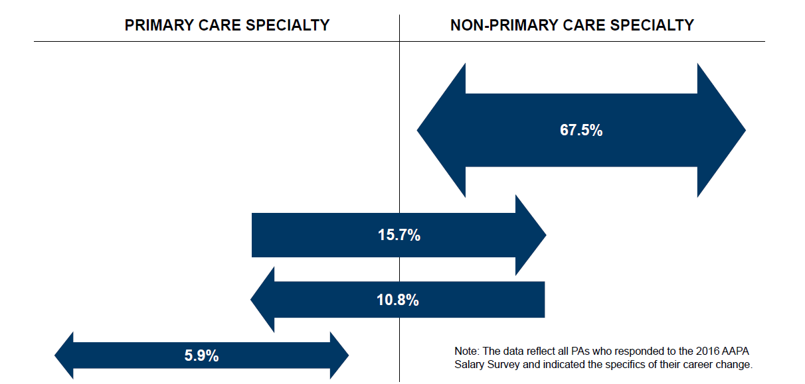
Key Findings 7 Patterns of Specialty Change

Slide 11
Summary
PAs who made a change in their professional career in 2015 …
Experienced more dissatisfaction with their employer, particularly those who changed employers
Experienced more life stress, particularly those who changed settings
Notes:
Note about effect size: In other words, they may be statistically different but is it clinically significant?

Slide 12
Implications
PAs are using the career flexibility inherent in the profession
PAs are uniquely positioned to meet changing healthcare needs, with the ability to move to specialties and settings as gaps arise
Employers should avail themselves of the PA profession to fulfill healthcare workforce needs

Slide 13
Future Research
Motivators of change
Longer term outcomes of change, including compensation, satisfaction and burnout, patient outcomes, employer profitability

Slide 14
Questions?
Noël Smith, MA
Senior Director, PA and Industry Research and Analysis
nsmith@aapa.org

