Slide 1
Module 10: Blueprint for Putting it All Together
Coaching Session with Amy Ingersoll, PA-C, MMS, FOMA
Coaching Session with Angela Golden, DNP, FNP-C, FAANP

Slide 2
Goals
Review clinical pearls from the webinar.
Answer questions about the clinical webinar.
Applying to practice case.

Slide 3
Agenda
PEARLS/review of clinical webinar | 5 minutes
Application to practice | 10 minutes
Q and A | 40 minutes
Preparing for next steps | 5 minutes
Notes:
Add in poll questions
Where are you at - location

Slide 4
PEARLS from Clinical Webinar
Obesity has different causes for different people and is not one disease.
Acknowledge that patients with a diagnosis are more likely to get treatment.
Staging the disease has value for morbidity and mortality.
No single eating plan is THE plan for everyone.
Recognize other providers that can support the obesity treatment team.
Treating obesity treats many other diseases seen and treated in primary care.
Recognize that there is greater urgency, with the need for more aggressive therapy, if the patient has complications and/or comorbidities with obesity.
This is a journey in a chronic, relapsing, AND treatable disease, so partner with your patient to provide long-term care.

Slide 5
Applying to Practice

Slide 6
Applying to Practice
Case Study:
Patient with Insulin resistance of 4.2 on HOMA-IR2 calculator is most likely to respond with reduction in weight to which of the following eating plans?
Whole food, plant-based
Mediterranean
Well Qualified Ketogenic Eating
DASH
Notes:
c

Slide 7
Applying to Practice
Medical management/evaluation includes which of the following:
Evaluating eating plan
Creating SMART goal
Evaluating physical activity
Making specialist referral
Notes:
d

Slide 8
Q and A
Notes:
Webinar and discussion posts

Slide 9
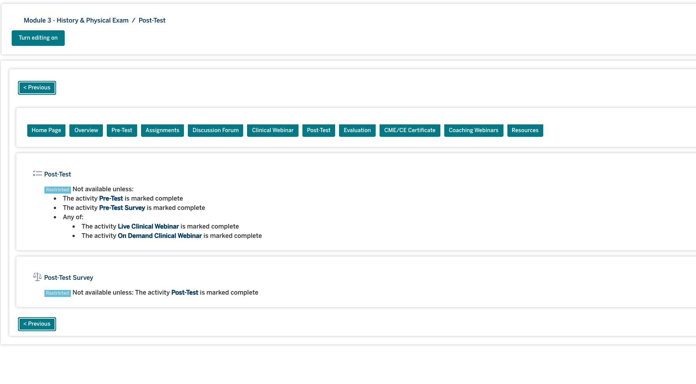
Action Items for Module 10
Post Clinical Webinar 10 – Items Monday October 26
Posttest
Evaluation
CME/CE Certificate
Post Coaching Webinar
Coaches’ Office Hours
Amy
Email for office hours
Angie
11/2, 7:30pmET – email invite coming with link
Please be sure to complete posttests and evaluations for each module.
Failure to complete these will result in your not being able to obtain your final program certificate from TOS.

Slide 10
What is Next - Dates to remember
Podcast Best of Obesity Week – late November or early December posted in LMS
FINAL ASSESSMENT will launch 11/29 – DUE 12/13
Reminder: to get final certificate all pre- and post-tests for clinical webinars and the FINAL assessment must be completed
Second PDSA area on LMS active!
GOAL 2: After making a diagnosis for obesity, document a recommendation for a follow-up visit specifically related to obesity in the EHR.
PDSA cycle wrap-up
Coaching sessions 11/15/21 PAs
7:30pm EST
Coaching sessions 11/16/21 NPs
11am EST
8pm EST
PDSA 2 Due date 12/10/2021

